Slide 1
BHARTI INFOTECH AND SERVICES
Bilaspur , Chhattisgarh
Introduction to Bread Board

Slide 2
Introduction
A breadboard is a construction base for prototyping of electronics. Originally it was literally a bread board, a polished piece of wood used for slicing bread. In the 1970s the solderless breadboard (a.k.a. plugboard, a terminal array board) became available and nowadays the term "breadboard" is commonly used to refer to these.
Because the solderless breadboard does not require soldering, it is reusable. This makes it easy to use for creating temporary prototypes and experimenting with circuit design. For this reason, solderless breadboards are also popular with students and in technological education. Older breadboard types did not have this property. A stripboard (Veroboard) and similar prototyping printed circuit boards, which are used to build semi-permanent soldered prototypes or one-offs, cannot easily be reused. A variety of electronic systems may be prototyped by using breadboards, from small analog and digital circuits to complete central processing units (CPUs).

Slide 3
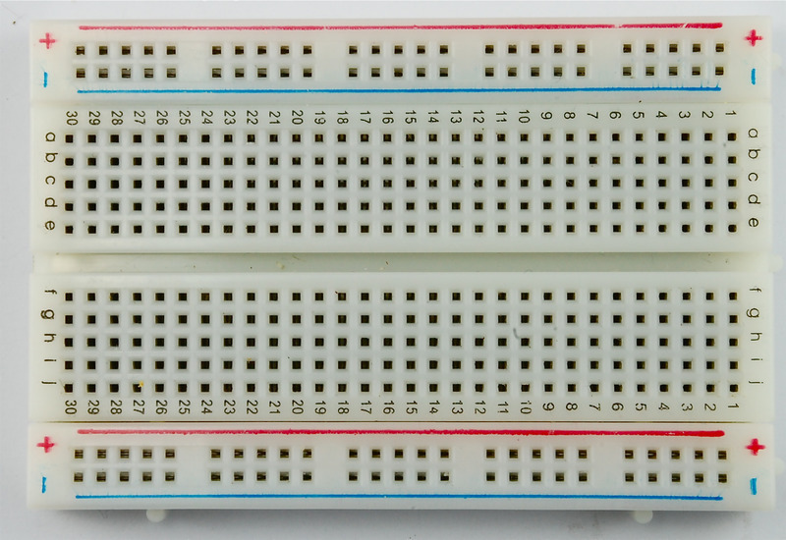

Slide 4
A breadboard also known as protoboard is a type of solderless electronic circuit building.You can build a electronic circuit on a breadboard without any soldering ! Best of all it is reusable. It was designed by Ronald J Portugal of EI Instruments Inc. in 1971. Building or prototyping circuits on a breadboard is also known as 'breadboarding '.In this instructable I will guide you how to use a modern breadboard to make simple circuits.
Here are various types of breadboard.Breadboard can be found in various sizes and functions.Early amateur radio hobbists used cutting board for bread to prototype there radios thus the name breadboard came. Some breadboards got built-in powersupply,some got power supply rail and some got only the prototyping section.

Slide 5
Basically, a bread board is an array of conductive metal clips encased in a box made of white ABS plastic, where each clip is insulated with another clips. There are a number of holes on the plastic box, arranged in a particular fashion. A typical bread board layout consists of two types of region also called strips. Bus strips and socket strips. Bus strips are usually used to provide power supply to the circuit. It consists of two columns, one for power voltage and other for ground. Socket strips are used to hold most of the components in a circuit. Generally it consists of two sections each with 5 rows and 64 columns. Every column is electrically connected from inside.

Slide 6
We will built some circuits and learn how a bread board practically works :-
For our first circuit we will be using resistor networks. Things we will need: 1.Breadboard 2.resistors 4x100ohm (brown,black,brown)(R1,R2,R3,R4) 3.Multimeter
Step 1: Take R1 and put one lead in A5 and another lead in A15 .Take R2 and put its leads to B15and B25. Now two resistors are in series mode Step 2: Now take your multimeter and set to measure resistence .Then put one lead on A5 another on A15.It should measure 100ohm.Now move the lead on A15 to A25 it should measure 200ohm.

Slide 7
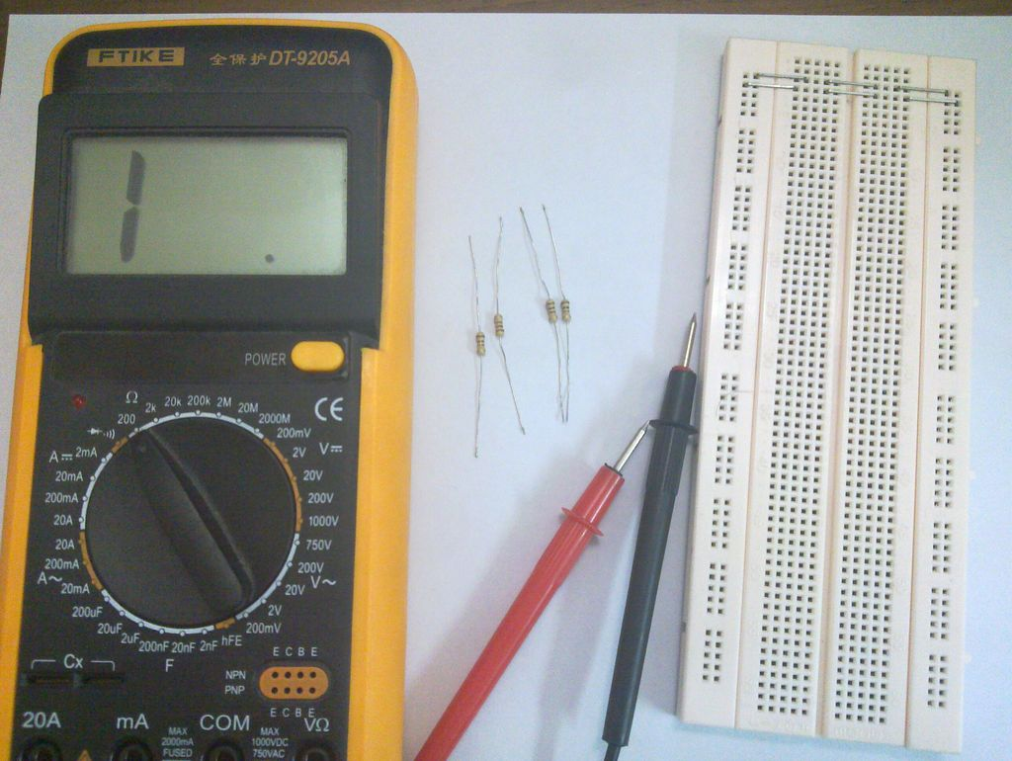
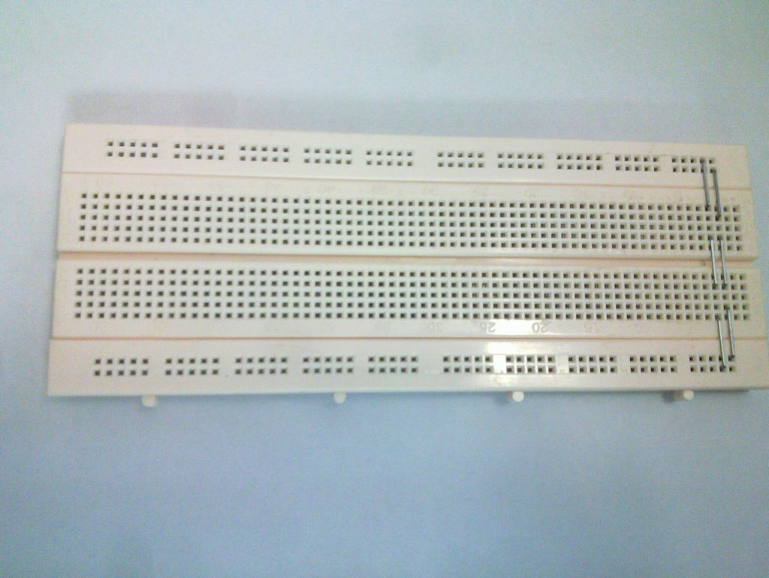
Step 3 :Take R3 and put one lead in D5 another in D15 and put R4 in E15 and E25. Step 4: Now measure from D5 and D15 .It will be 50ohm and measure D5 and E25 .It should measure 100ohm SO what does it mean ?? It means R1 and R2 are series because they arent in the same lane and R1 and R3 are parallel because they are in the same lane.

Slide 8
Now with LEDs !!! What we will need: 1.LED (white) 2.300 ohm resistor (orange-black-brown) 3.solid copper jumper wire 4.9volt power supply/battery STEPS
1.Put the LED on the breadboard 2.Put a jumber wire on the anode side and one leg of the resistor on the cathode side of LED 3.Insert the wire on the positive power bus and other leg of the resistor on the negative power bus.

Slide 9
